Slide 1

Sign Language Recognition Using ConvLSTM and Bi-GRU
Project Report Submitted in Fulfilment of the Requirements
for the Degree of
Master of Computer Applications
in
Computer Science and Engineering
Submitted by
Mahak Gupta: (Roll No. 2022PGCSCA056)
Under the Supervision of
Dr. Dilip Kumar Shaw
Department of Computer Science & Engineering
NIT Jamshedpur
2022-25

Slide 2
Introduction
This project is about building a real-time Sign Language Recognition system.
Sign language is an important medium of communication for the deaf community. Our goal was to build a system that can automatically recognize hand gestures in real-time.
It combines two models — ConvLSTM2D for static alphabet signs, and Bi-GRU with Attention for dynamic video signs.
We trained on two datasets: Sign MNIST for alphabets, and WLASL for real-world sign videos.
These two lightweight deep learning models are capable of working efficiently even without heavy hardware.

Slide 3
Objective
Develop a hybrid Sign Language Recognition (SLR) system for both static and dynamic signs.
Use ConvLSTM2D for recognizing static ASL alphabets from the Sign MNIST dataset.
Use Bi-GRU + Multi-Head Attention to recognize dynamic sign words from video sequences (WLASL).
Enable real-time predictions using webcam/video input.
Reduce computational load by using keypoint-based input (MediaPipe), avoiding full-frame CNNs.
Ensure system is lightweight, scalable, and deployable on regular hardware..

Slide 4
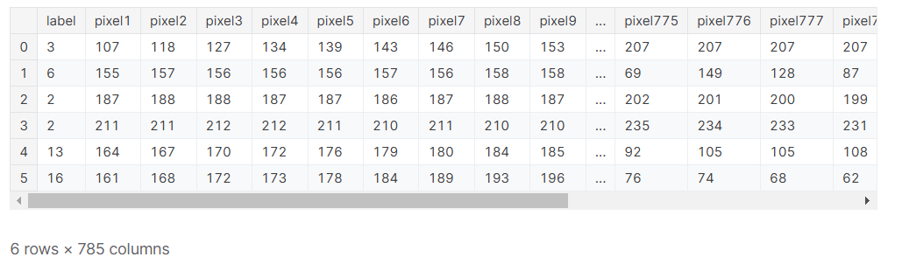
Dataset Visualization(MNIST)
The dataset format is patterned to match closely with the classic MNIST.
Each training and test case represents a label (0-25) as a one-to-one map for each alphabetic letter A-Z (and no cases for 9=J or 25=Z because of gesture motions).
The training data (27,455 cases) and test data (7172 cases) are approximately half the size of the standard MNIST but otherwise similar with a header row of label, pixel1,pixel2….pixel784 which represent a single 28x28 pixel image with grayscale values between 0-255.

Slide 5
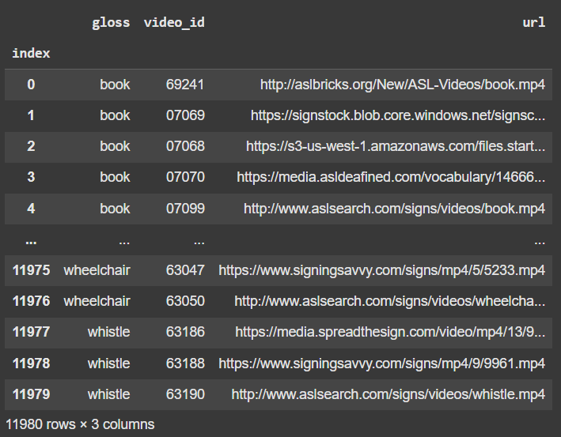
Dataset Visualization(WLASL)
WLASL is the largest video dataset for Word-Level American Sign Language(ASL) recognition, which features 2,000 different words in ASL.
Each video in the WLASL dataset was processed to extract a sequence of frames uniformly distributed across its duration
Made by Dongxu Li and Hongdong Li..

Slide 6
Data Preprocessing(MNIST)
1. Data Loading: The dataset was loaded and split into training and testing sets as follows:
Training Set: 27,455 images, Testing Set: 7,172 images
2. Normalization: To improve training efficiency and stability, we normalized the pixel values from the original range [0, 255] to [0, 1]
3. Reshaping for ConvLSTM: Since the ConvLSTM model expects input in the format (time steps, height, width, channels), we reshaped the images from (28, 28, 1) to (1, 28, 28, 1) where:1 represents the time step
4. One-Hot Encoding of Labels: Since we are performing multi-class classification (25 classes), we converted the labels into a one-hot encoded format to be compatible with the categorical cross-entropy loss function.

Slide 7
Data Preprocessing(WLASL)
1. Data Loading: The WLASL dataset was loaded from Kaggle and filtered to select the Top-10 most frequent signs.
2. Frame Sampling: Extracted 10 evenly spaced frames from each video to standardize input.
3. Keypoint Extraction: Instead of using full video frames, we used MediaPipe Holistic to extract 3D skeletal keypoints (pose + hands) from each frame, creating 1000-dimensional feature vectors.
4. Sequence Formatting: Formatted each video as a sequence of 10 frames × 1000 features, matching Bi-GRU + Attention model input: (10,1000).
5. One-Hot Encoding of Labels: Converted class labels (0–9) into one-hot encoded vectors for multi-class classification.
6. Data Augmentation: Applied jittering (small noise) and frame dropout to enhance model robustness.

Slide 8
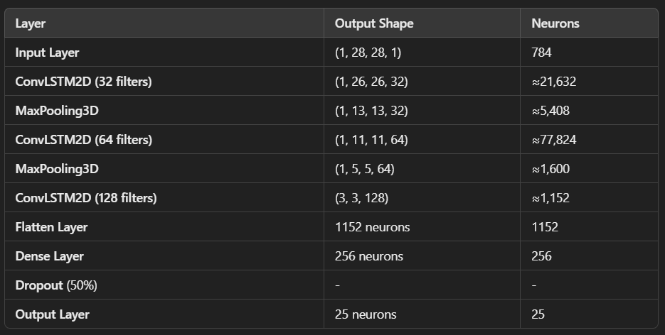
Model Architecture(MNIST)
The model is built using the Sequential API in TensorFlow/Keras, which allows us to stack layers sequentially.
Used three ConvLSTM2D layers to extract spatial and short-term temporal features from images.
Added MaxPooling3D and Dropout layers to reduce overfitting and down sample features.
Flattened the 3D output into 1D.
Dense layer with 128 neurons for pattern learning.
Final Dense layer with 25 outputs (SoftMax) for class prediction

Slide 9
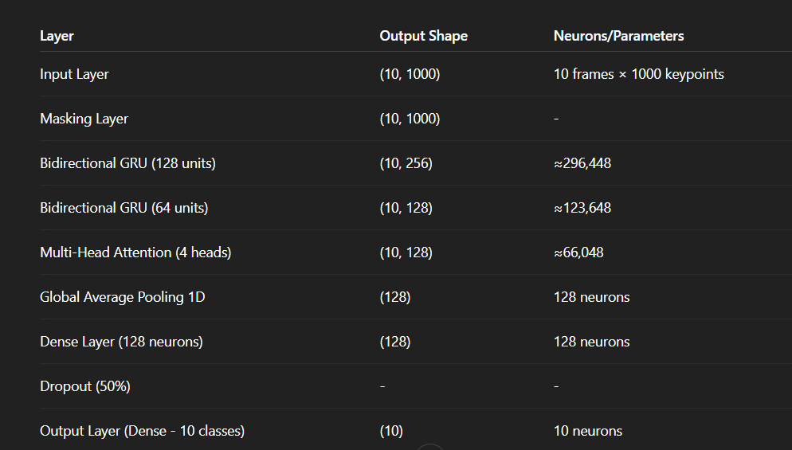
Model Architecture(WLASL)
Input is 10 frames of 1000-length keypoints per frame.
Masking layer to ignore any missing frames.
Two Bidirectional GRU layers to capture temporal patterns from both past and future frames.
Multi-Head Attention layer to focus on important frames while ignoring irrelevant ones. Global Average Pooling reduces across time dimension.
Dense layer to classify into one of the 10 dynamic signs.

Slide 10
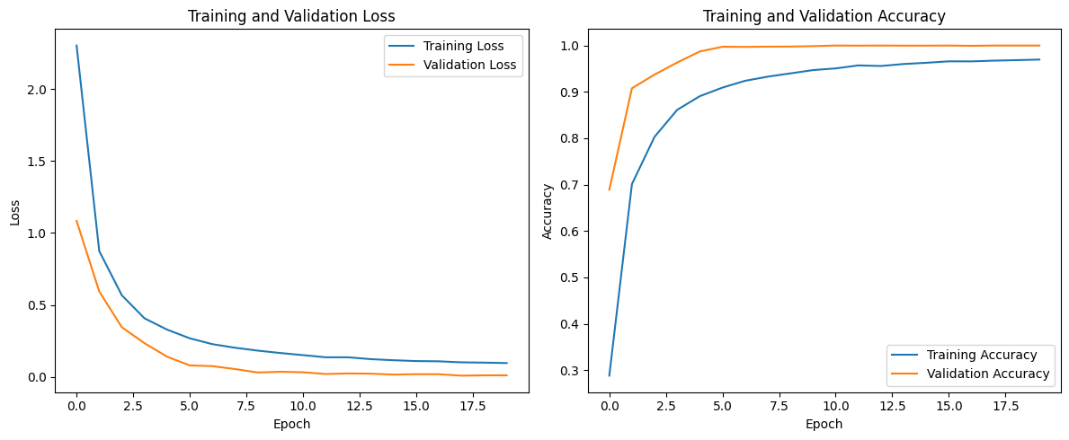
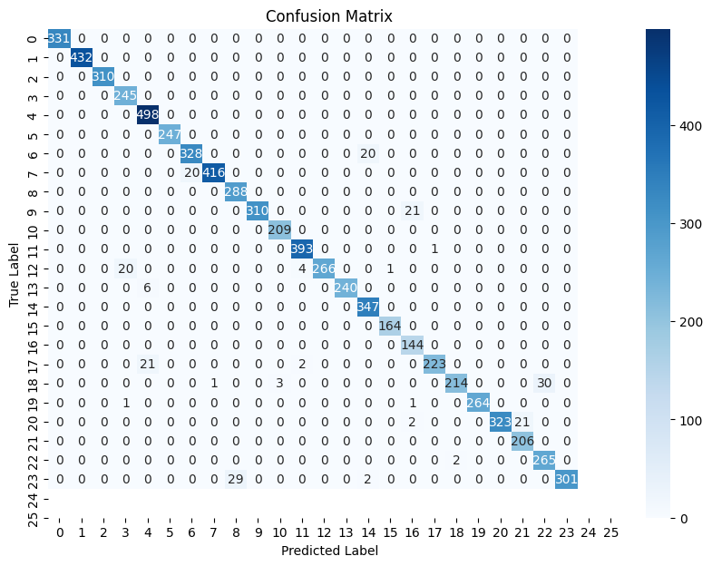
Evaluation Results(MNIST)
Loss Curves:
Both training and validation loss are decreasing smoothly, with validation loss staying close to training loss. This suggests minimal overfitting.
Accuracy Curves:
Achieved 97.1% accuracy on the Sign MNIST test set.

Slide 11
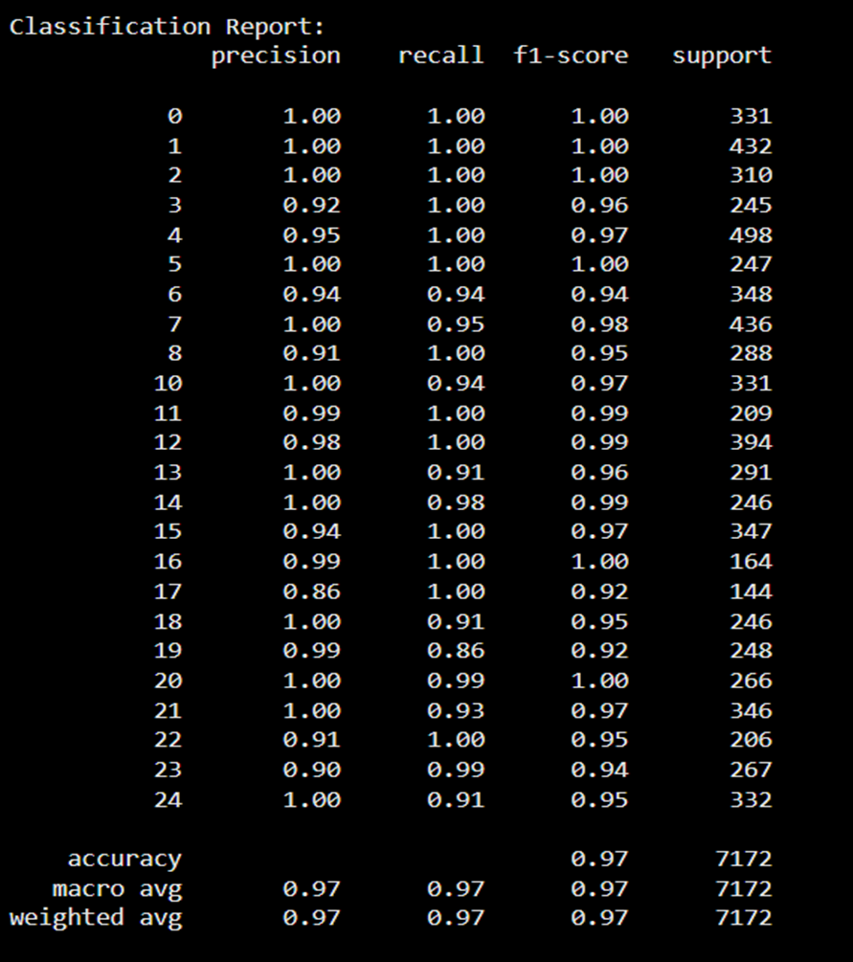
Evaluation Results(MNIST)(Contd.)
In terms of class-wise performance, the classification report demonstrates high precision, recall, and F1-scores across all 25 classes.
Most classes show F1-scores of 0.95 and above, reflecting strong per-class generalization. The macro and weighted F1-scores are both 0.97, supporting the model's balanced accuracy across the dataset.
The high macro and weighted F1-scores of 0.97, along with minimal class confusion, confirm the model’s robustness and potential for real-world deployment

Slide 12
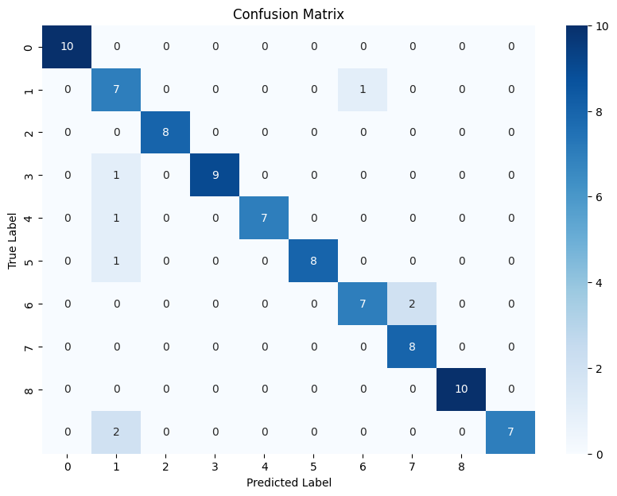
Evaluation Results(WLASL)
Achieved 91.01% accuracy on the Top-10 selected classes from WLASL.
Confusion matrix showed that most signs were predicted accurately, with few misclassifications.
Precision, Recall, and F1-score were all balanced across classes.

Slide 13
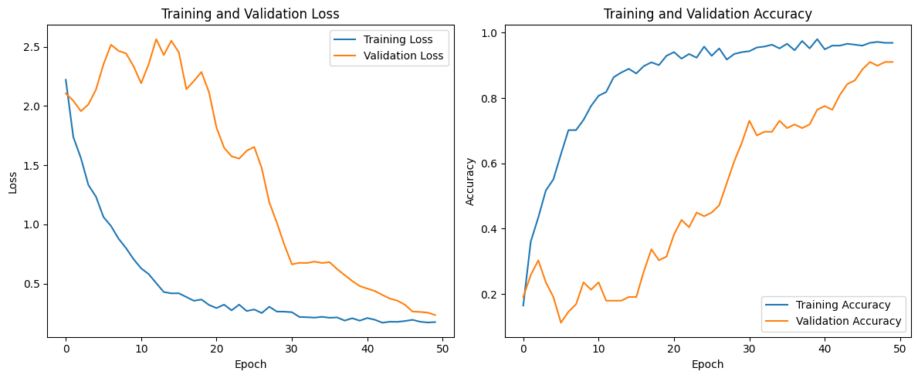
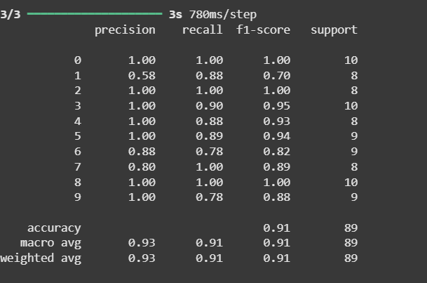
The overall accuracy reached 91.01%, with macro and weighted F1-scores both at 0.91, indicating strong generalization despite variations in signer and background.
The inclusion of Multi-Head Attention enhances the model's ability to focus on relevant frames, a feature not present in most recurrent networks evaluated in prior work.

Slide 14
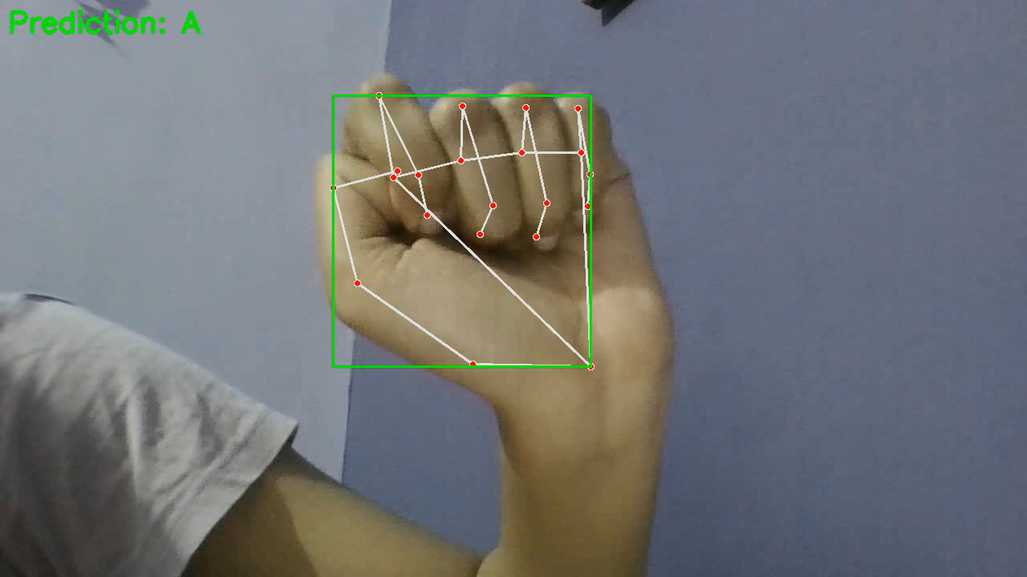
Real-Time Prediction(MNIST)
Live video input was captured frame-by-frame using OpenCV.
Each frame was resized to 28×28, converted to grayscale, and normalized.
The frame was reshaped and passed to the trained ConvLSTM2D model for prediction.
Predictions from all frames were collected, and the most frequent letter was selected as final output.
The final predicted alphabet was displayed on-screen in real-time using OpenCV.

Slide 15
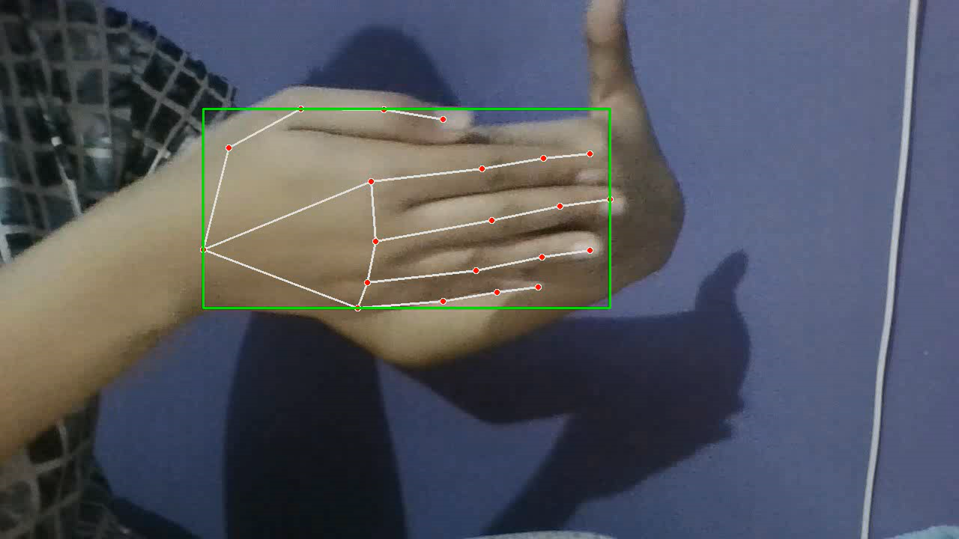
Real-Time Prediction(WLASL)
Live video captured through webcam was processed frame-by-frame.
MediaPipe Holistic extracted keypoints from each frame in real-time.
Each frame's keypoints passed to the trained model for prediction.
A majority voting system across all frames determined the final output sign.
The final prediction was overlayed onto the video in real-time.

Slide 16
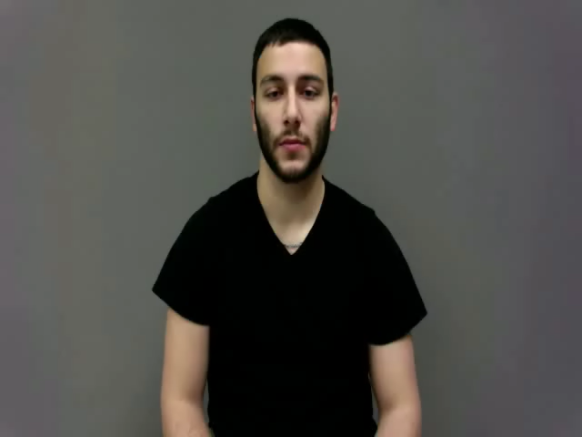
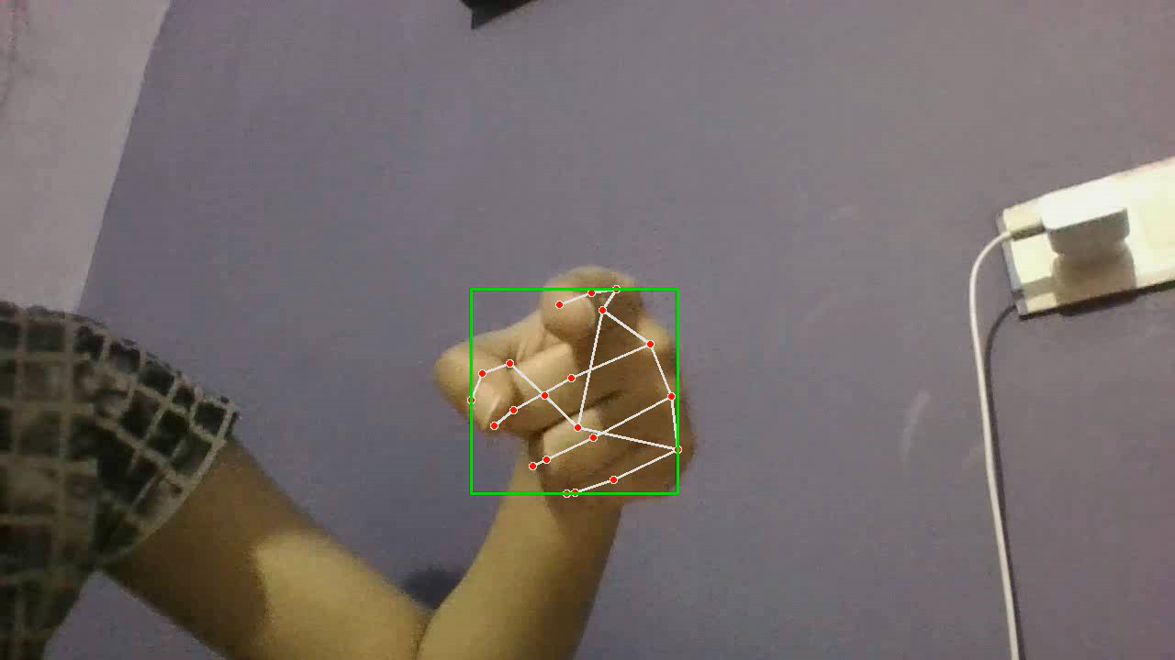
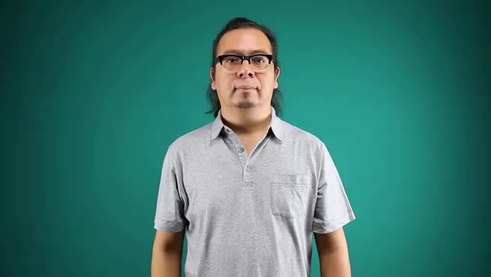
Screenshot videos of testing in real-time

Slide 17
Results And Discussion
Work | Dataset | Model | Accuracy | Special Point
Li et al. (2020) | WLASL | Pose-TGCN | 66% (Top-10) | Skeletal keypoints
Beauden John (2021) | Multiple Public Datasets | CNN, BiLSTM, CNN-BiLSTM | CNN-BiLSTM~85% | Image Sequences
Srivastava & Mehta (2022) | ISL | LSTM + MediaPipe | 88.23% | Continuous recognition
Kumar et al. (2023) | Custom | CNN + MediaPipe | 99.95% | Real-time alphabet recognition
Our Work | WLASL + Sign MNIST | Bi-GRU + Attention + ConvLSTM2D | 91%/97% | Lightweight real-time system
Compared to previous work, our system achieves high accuracy using lightweight architectures suitable for real-time deployment.

Slide 18
Challenges Faced
Signer Variability: Differences in hand size, speed, and angles affected accuracy. Used MediaPipe keypoints + frame dropout to improve generalization.
Video Quality: Low resolution or lighting in some WLASL videos made keypoint detection harder. Applied jittering and selected clean frames.
Data Imbalance: Some signs had fewer samples — managed with Top-10 filtering and class weights.
Real-Time Processing: Ensuring smooth prediction on CPU needed optimization. Optimized frame size and used lightweight models.
Frame Noise: Flickering and missed frames during webcam input — handled using majority voting and data augmentation.
Overlay & Output: Displaying predictions on video required OpenCV integration and tuning.

Slide 19
Future Work
Extend models to recognize full sentences or phrases using continuous gesture recognition.
Implement signer-adaptive learning where the system adapts to a particular user’s style.
Fuse additional modalities like facial expressions and lip movement for richer recognition.
Deploy lightweight version of models to mobile phones and embedded devices for offline use.
Following expansion to larger and more varied sign language corpora—regional, non-ASL variants—will ensure verification of the models' robustness in multilingual and multicultural scenarios.

Slide 20
Conclusion
Built a complete real-time system for static and dynamic sign language recognition, consisting of a ConvLSTM2D network for static alphabet classification and a Bi-GRU with Multi-Head Attention for dynamic sign word recognition.
Achieved 97.1% accuracy on static signs and 91% on dynamic signs.
Used lightweight, efficient models that do not require high-end GPU or hardware.
Comparisons with current literature affirm that our framework is superior in terms of accuracy as well as computational cost.
The system lays foundation for future real-world communication tools.

Slide 21
Thank you for your attention! I’m happy to take questions.

